Slide 1

Python powered Credit Card Fraud Detection
Machine Learning Project
Done by:
1.Aaqib Rashid Mir
2.Supriya Payaveni
3.Bommeneni Ganesh
4.Basava Sanketh BN
5.Kundan Pandey
6.Sanjeet Soni
Under the Guidance of :
Ganesh sir

Slide 2

Agenda
Data Collection
EDA
Data visualisation
Model building
Model Evaluation
Model Testing

Slide 3
Problem Statement
Our Goal is Build a machine learning model in Python that can detect fraudulent credit card transactions with a high degree of accuracy.
The model should be able to identify fraudulent transactions with minimal false positives, and should be able to handle large datasets.

Slide 4

Introduction to Detecting Credit Card Fraud Using Python
Credit card fraud is a major problem for banks and cardholders alike.
It is estimated that the global cost of credit card fraud is over $20 billion a year.
Fortunately, there are ways to detect and prevent credit card fraud using Python.

Slide 5
Data Collection
We have got dataset from the Kaggle
https://www.kaggle.com/mlg-ulb/creditcardfraud
This dataset was cleaned and pre-processed with 31 columns and 284708 rows
We modified the dataset and applied under-sampling and over-sampling in order to make the dataset balanced
We have scaled the amount column and dropped the time column

Slide 6

EDA
We have seen the correlation
Feature engineering
Feature scaling (Standard Scaler)
Checking for missing and duplicates values

Slide 7
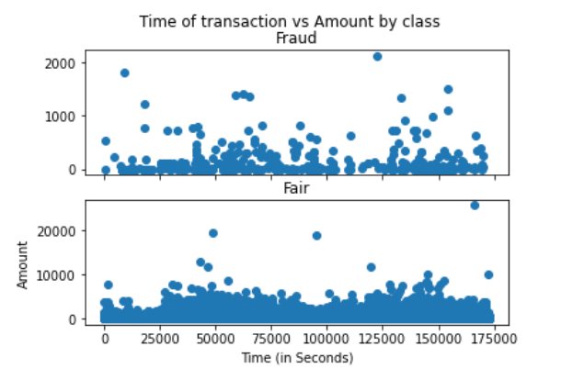
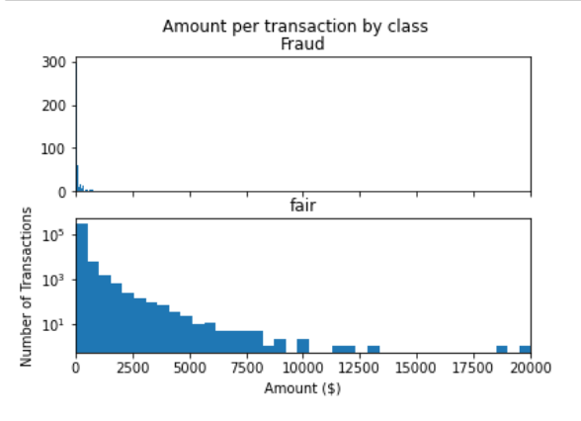
Data visualisation

Slide 8
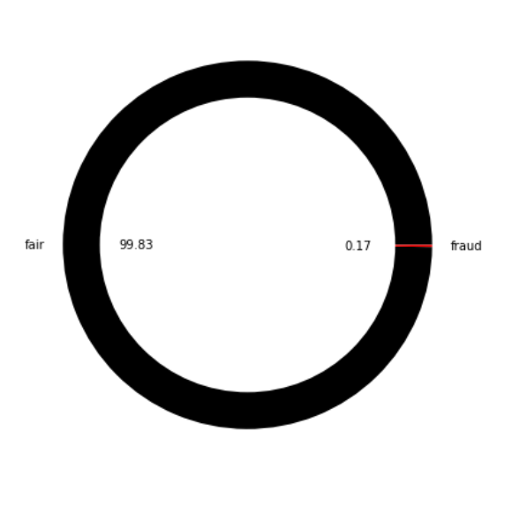
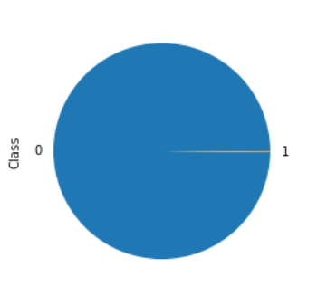
Percentage of fraud and fair classes

Slide 9
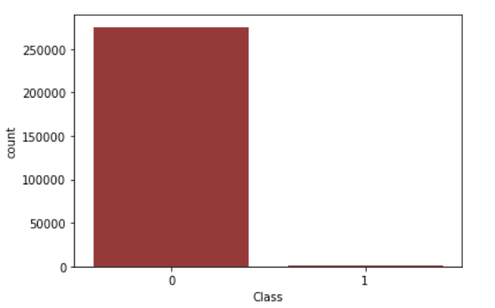
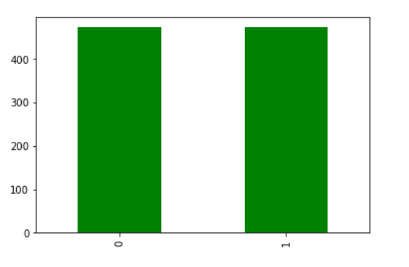
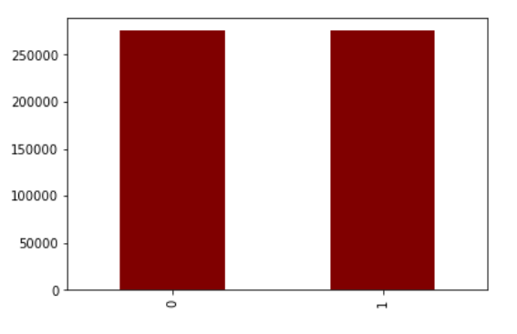
Class distribution
Imbalanced
Under sampling
Over sampling

Slide 10
Model building
We have trained one model on imbalanced dataset and it resulted bad accuracy and bad F1-score (over-fitted)
We under-sampled the output class and tried different models on new data (under-sampled) and we got the good accuracies
We oversampled the output class and applied Lazy-predict on the final data (over-sampled)
We trained different models using Lazy predict and finally selected the best models (Random Forest Classifier)

Slide 11
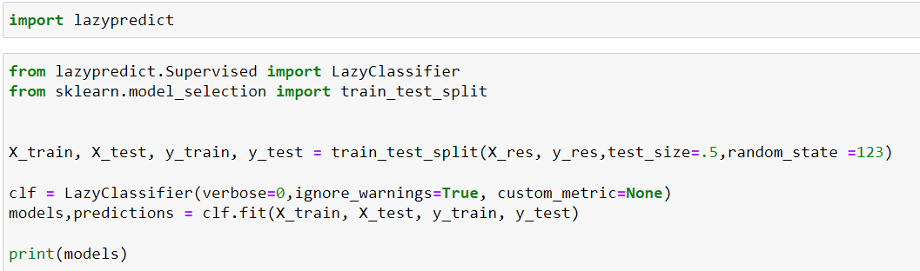
Lazy Predict
We have Used Lazy Predict which is an awesome Python library that helps us to quickly build machine learning models at scale and choose the best suitable model and helps us to understand which models works better without any parameter tuning

Slide 12
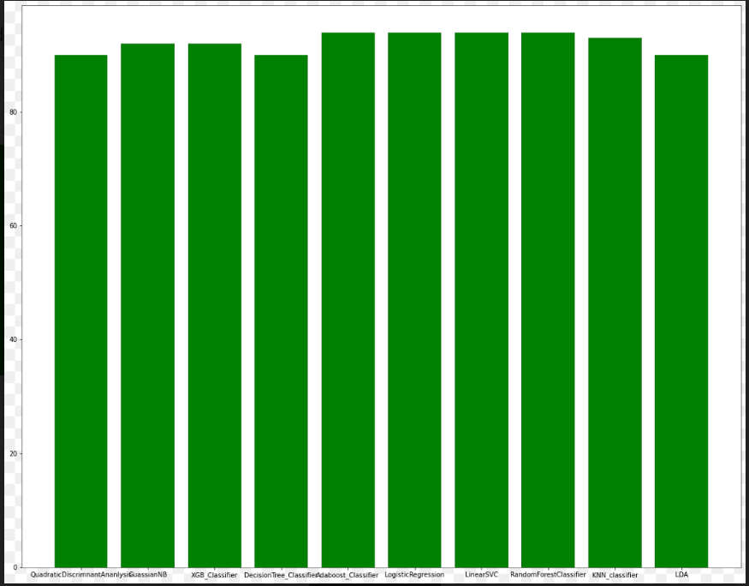
Model vs Accuracy

Slide 13
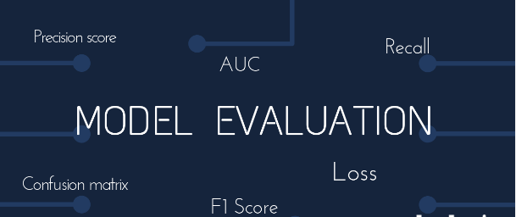
Model Evaluation
In the model evaluation we have found the accuracy, precision, F1 score and recall for all the models that we have used
We come up the best model with nice metrics score ( accuracy, F1 score)

Slide 14
Model Testing

